Slide 1
LIBRARY MANAGEMENT SYSTEM
By: Anshul Toshniwal(RA2011031010081)
Sanskar Bohora(RA2011031010111)
Sanchal Jain(RA2011031010072)
Prateek Jain(RA2011031010082)

Slide 2
Overview
Implementation starts with entering and updating master records like Book Details, Library Information.
Any further transaction like Book Issue, Book Return will automatically update the current books.
It will track on the how many books available in library and books issued to the students.

Slide 3
Purpose
To provide a friendly environment to maintain the details of books and library members.
To maintain the circulation system using computers and to provide different reports.
Improved customer service through greater access to accurate information.
Greater accountability and transparency in operations.

Slide 4
Scope
Only covers the requirements specifications for the library management system.
Does not provide any other information about library management system.
Does not provide any references to the other component of the library management system.
All the dependencies are also identified in this document.
Updates the manually library sysyetm into a software based application.

Slide 5
User Characteristics:
We have two levels of users
1. User Side- In user side, user will check the availability of the books.
- Book return
2. Administration Side- The following are the sub module in the administration side.
- Register user
- Entry book details
- Book issue

Slide 6
Requirements
Functional Requirements:
Book Entry: In this module we can store the details of the books.
Register Student: In this module we can keep the details of the new student.
Book Issue: This module is used to keep the track of book issue details.
Book Return: This module enables to keep a track of returned books.

Slide 7
User Requirements
Provides good graphical interface for the user.
Any administrator can operate on the system, performing the required task such as create , update, viewing the details of the book.
Allows user to view quick reports like book issue/Return etc., In between particular time.
Stock verification in different criteria or according to different –different categories.
Search facility based on different criteria in depth.

Slide 8
System requirements:
The system should prompt for the user and administrator to login to the application and for proper input criteria.
Hardware Requirements:
Operating system: Windows
Hard disk: 500GB
RAM: 2GB
Processor: intel core-i3

Slide 9
Non Functional Requirements
Safety requirements:
The database may get crashed at any certain time due to virus or Operating system failure. Therefore, It is required to take the database backup.
Security Requirements:
Access rights are decided to prevent from unauthorized access.
Hardware Constraints:
The system requires a database in order to store the persistent data. The database should have backup capabilities .

Slide 10
Software Requirements:
Java Language
Oracle Database

Slide 11
Screenshots:

Slide 12
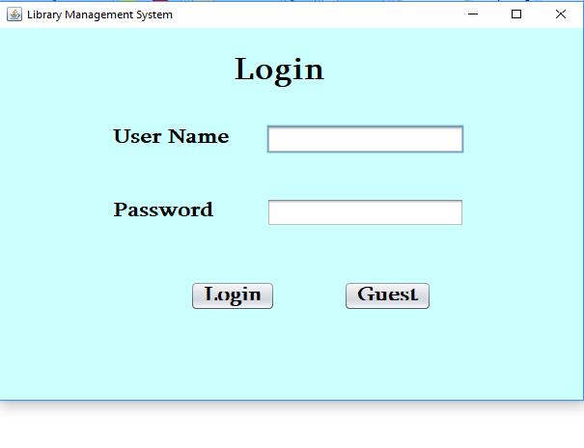

Slide 13
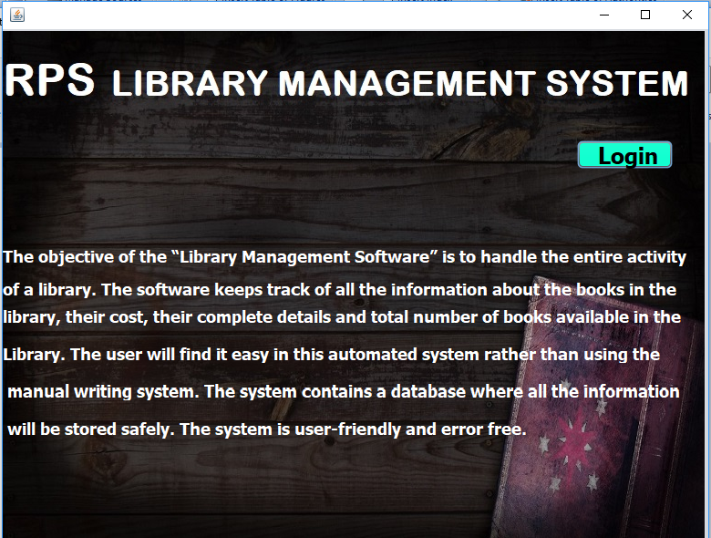

Slide 14
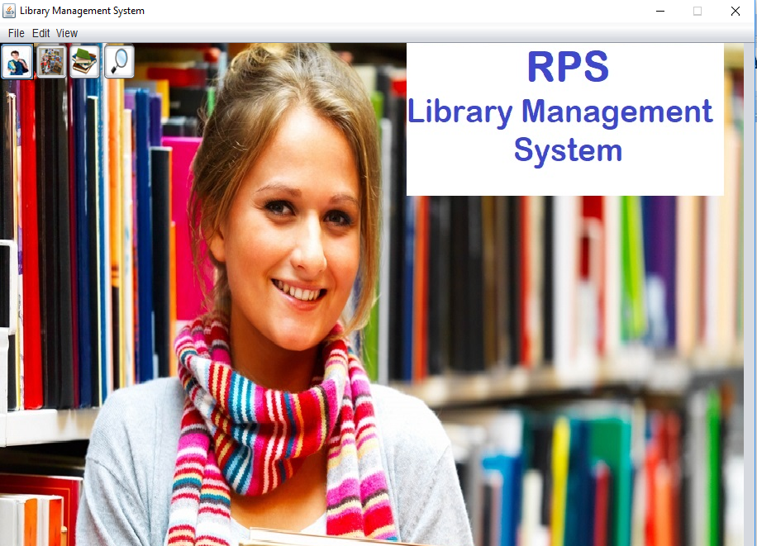

Slide 15
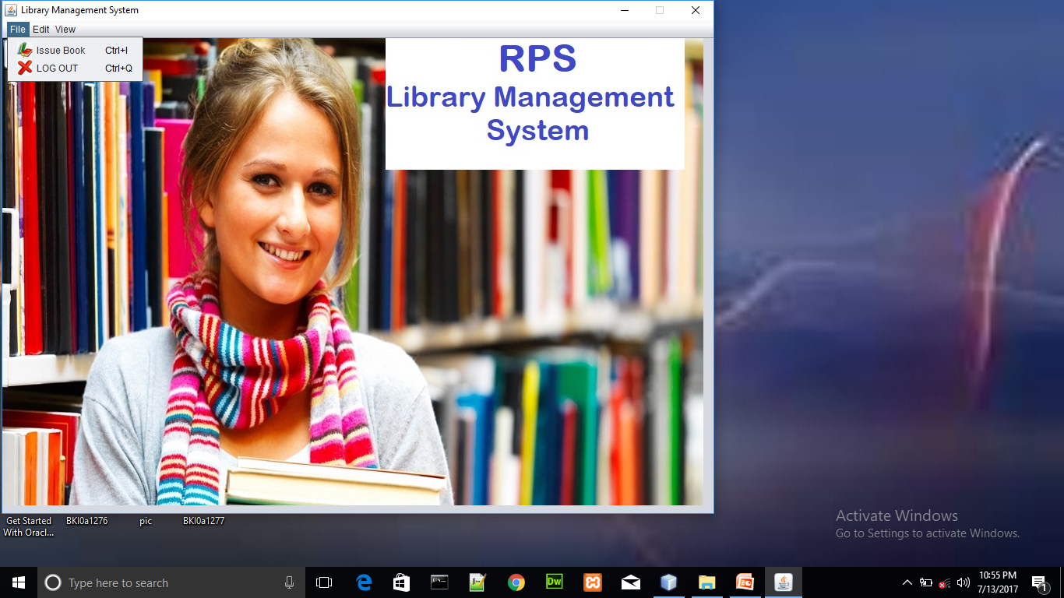

Slide 16
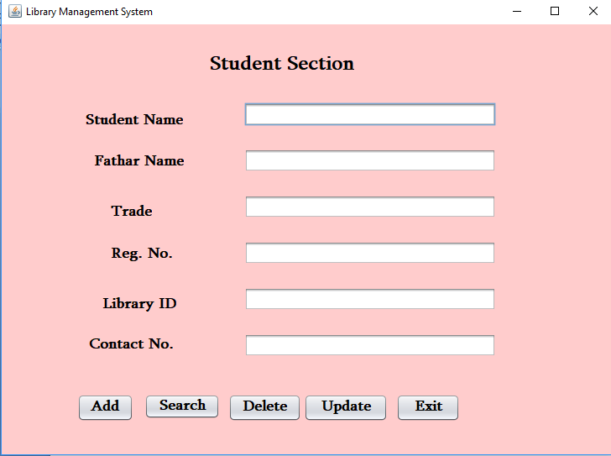

Slide 17


Slide 18
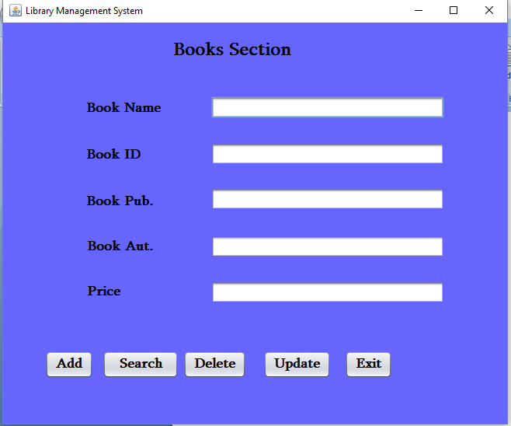

Slide 20
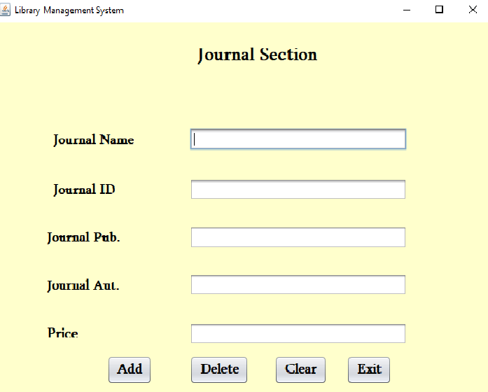

Slide 21
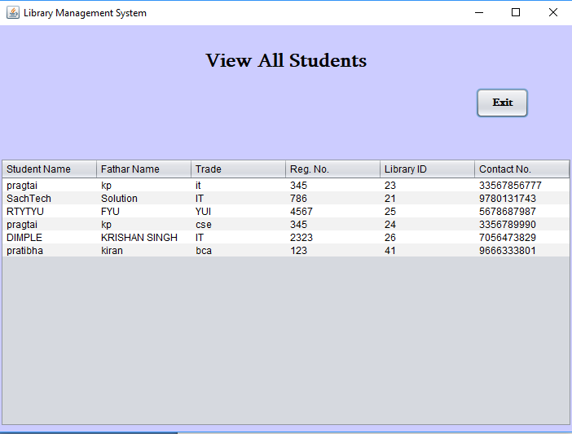

Slide 22
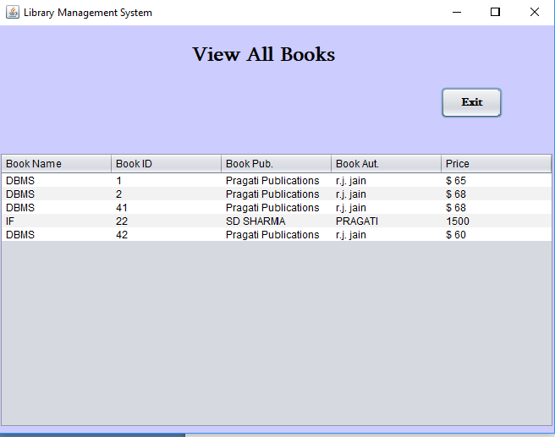

Slide 23
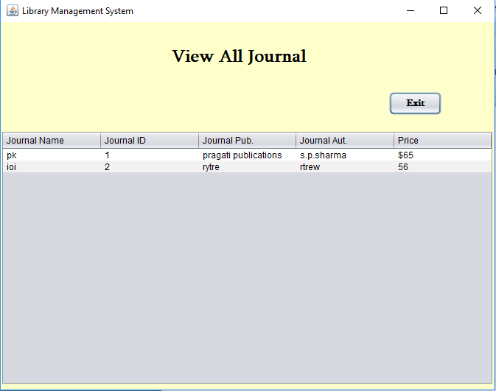

Slide 24
Conclusion
It will take care of the current book detail at any point of time.
The book issue, book return will update the current book details automatically show that user will get the update current book details.
The main purpose of this project is to reduce the manual work.
This software is capable of managing book issues, returns, and calculating/managing fines.
Generating various reports for record keeping according to end user requirements.

Slide 25
Thank You!!!!

